Slide 1
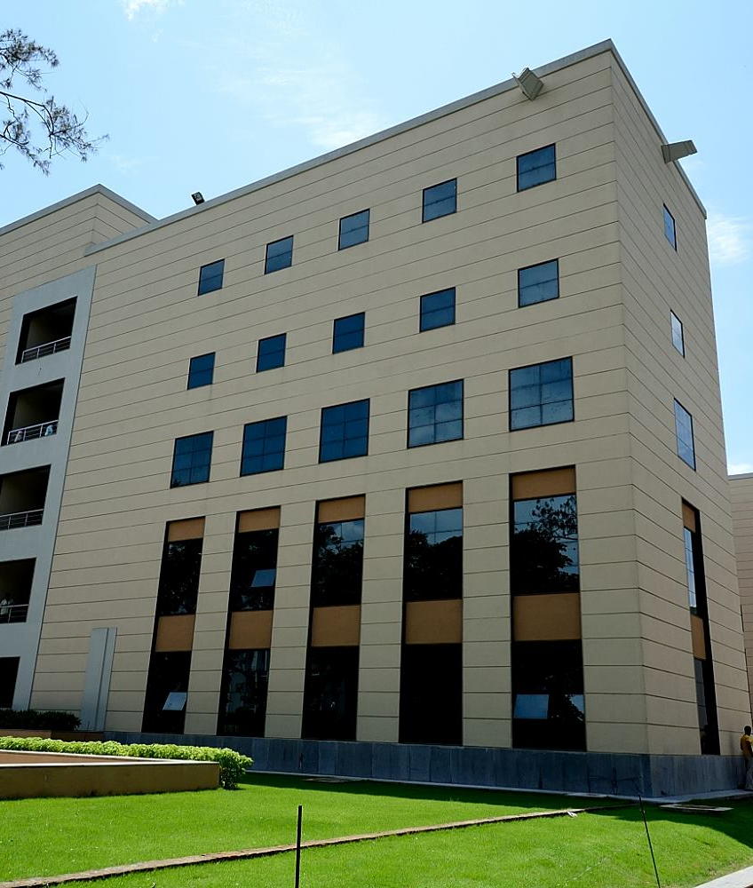

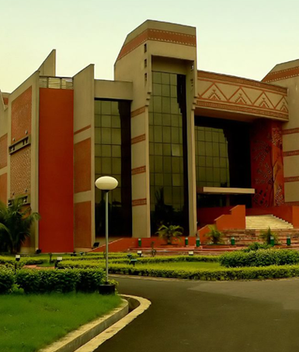


IIM Calcutta welcomes prospective applicants to
PGPEXplain

Slide 2

About us
Established in 1961 in collaboration with Alfred P. Sloan School of Management (MIT), the Government of West Bengal, The Ford Foundation and Indian industry
Vision: to emerge as an International Centre of Excellence in all facets of Management Education, rooted in Indian ethos and societal values.
Strong Industry Connect, Globally renowned Faculty
Currently offering 4 full time management programs and multiple corporate learning initiatives

Slide 3
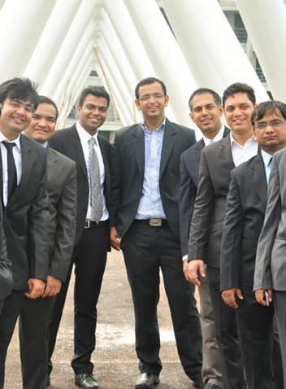
Post graduate program for executives
IIMC’s One year Full Time Residential MBA Program
Mission: to develop experienced and ambitious executives for leadership positions in global organizations
Ideal platform for mid-career and senior Professionals to augment existing skill-set for senior and top management roles

Slide 4
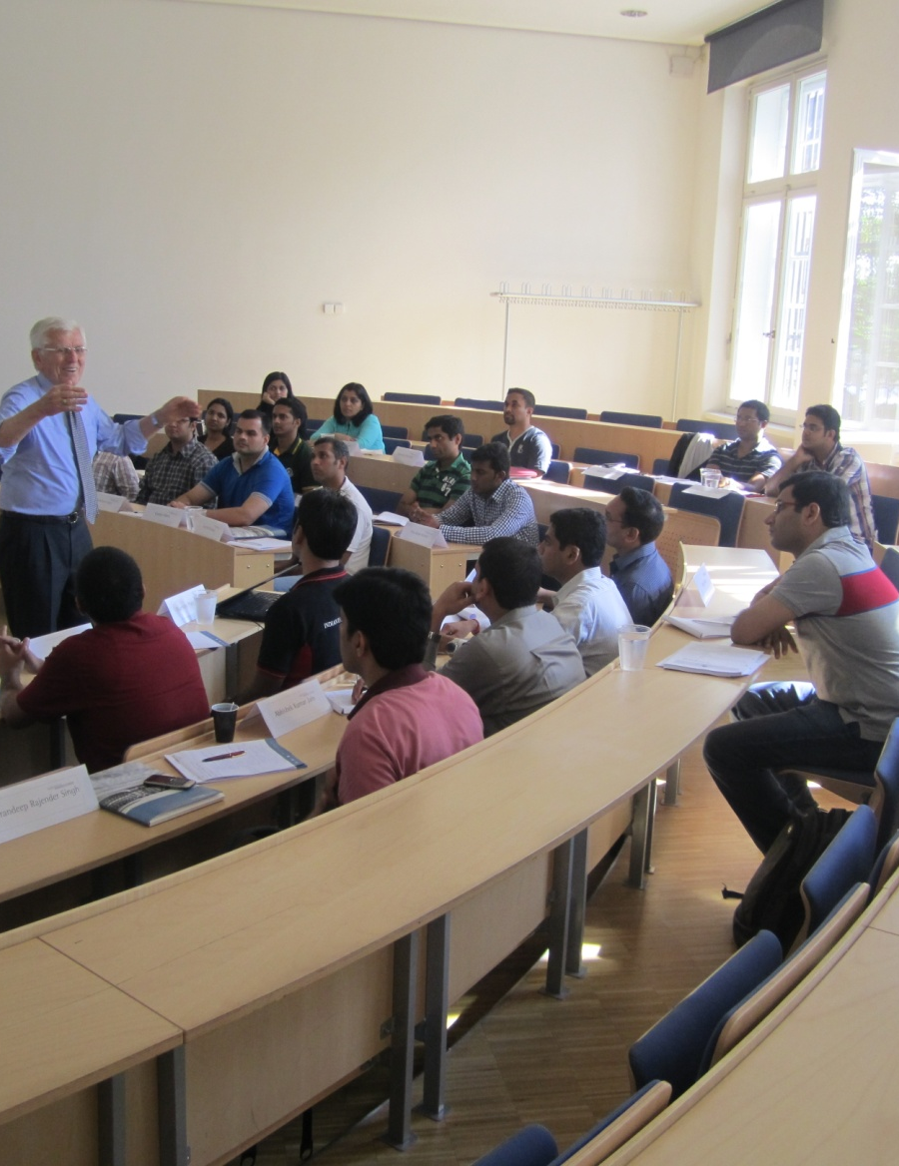
Why PGPEX ?
PGPEX
Case Analysis
Global Outlook
Decision Making
Diverse Peer Group

Slide 5

Lets chat on social media
IIM Calcutta Article on Social Media

Slide 6
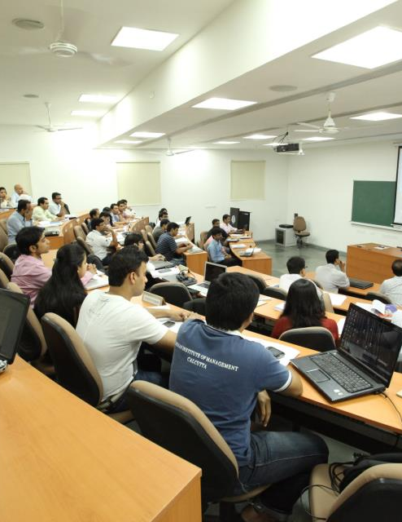
Pgpex advantage
Largest Choice of Electives
International immersion
Leadership Talk Series
Small Batch Size
Diverse Work Experience
The Alumni Network
IIM Calcutta Brand Value
Campus Accommodation
Cumulative experience of 400 years across 15 industries

Slide 7
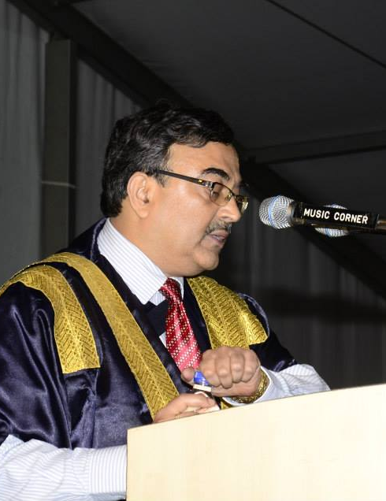
The Best faculty
90 Full Time Faculty across Domains
Strong Industry Connect
Visiting International Faculty
Guest faculty from leading corporations
The Ambassador

Slide 8

The course structure
PGPEX
Exhaustive Curriculum
6 terms, 810 Contact Hours, 27 Compulsory and 40+ elective offerings
Unique Pedagogy
Blend of theory, case discussions, simulation games and group projects
International Immersion
Across top American, European and Australian Business schools
Innovative Curriculum
Designed to Develop Decision Making Abilities, Analytical, Team-work and Communication Skills.

Slide 9

The proposed course structure
 | Existing Curriculum | New Curriculum
Total Compulsory Courses | 17 | 14
Total Electives | 18 | 15
Total Contact Hours | 810 | 690

Slide 10
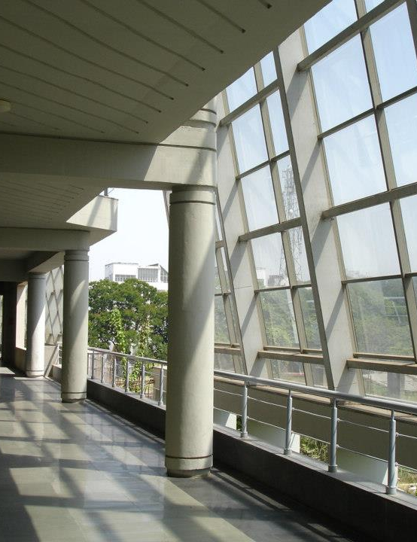
Centres for excellence
Finance Lab
Management Centre for Human Values
IIM Calcutta Case Research Centre
Centre for Entrepreneurship & Innovation
Centre for Corporate Governance

Slide 11
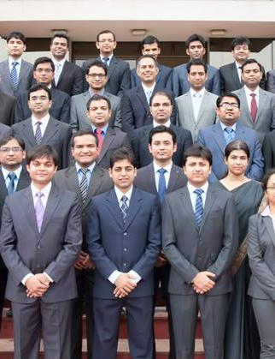
Batch profile (class of 2015)
Class Size
50
Average Work Experience
7.6 years
Average Intl Work Exp
14 months
Average GMAT Score
702

Slide 12
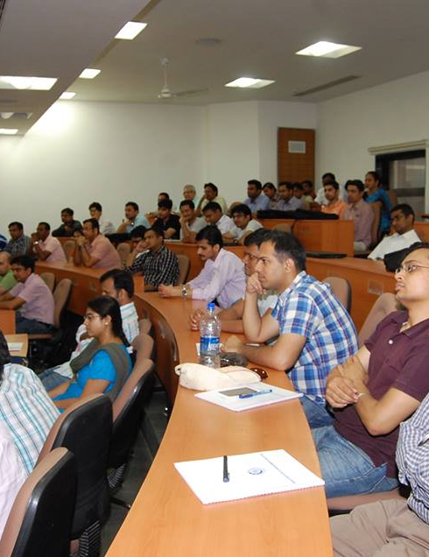
PGPEX class of 2015

Slide 13
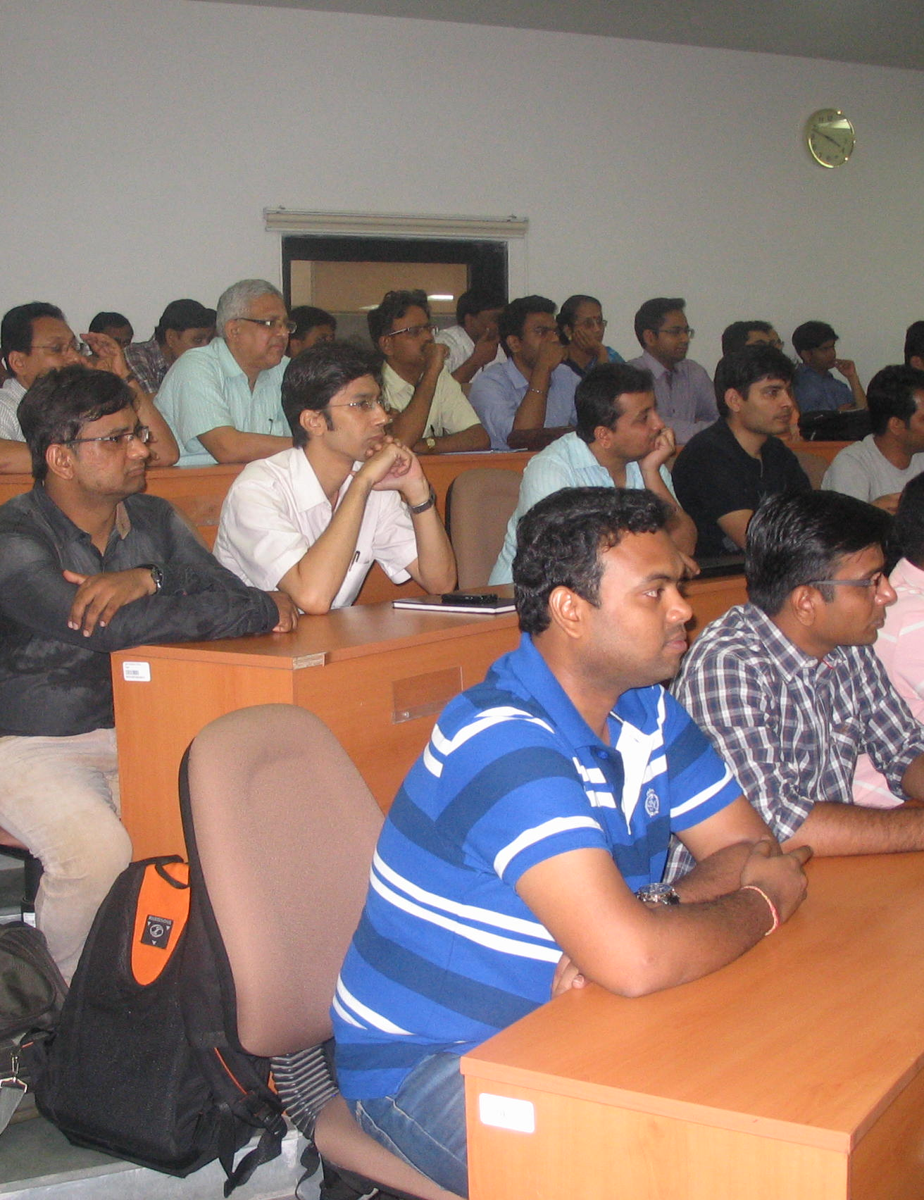
PGPEX class of 2015, experience

Slide 14

Beyond the classroom

Slide 15

PGPEX’s Annual Business syposium
Shekhar Gupta
Prashant Pandey, CEO, Radio Mirchi
Sudipta Sen
Regional Director - SAS
E. Sarath Babu
CEO Foodking
Lattice is a platform that facilitates interaction between transformational leaders of Indian society and IIM Calcutta students
The theme based event has had the following themes over the past years
Previous years’ themes
  Innovations for India ~ 2011
  Winds of Change ~ 2012
More details of the event at www.latticeiimc.in

Slide 16









Student clubs

Slide 17
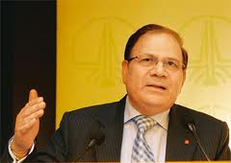
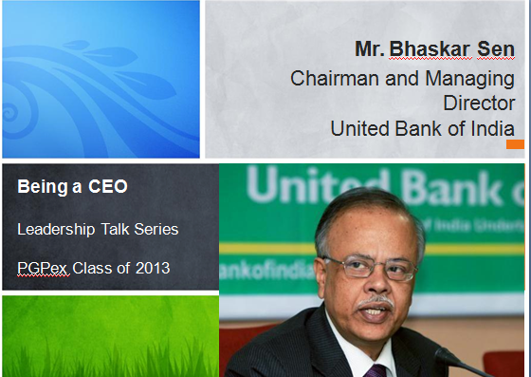
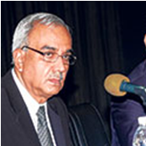
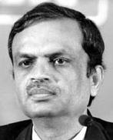
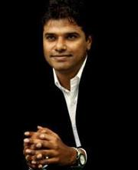
Being a ceo (PGPEX Leadership lecture series)
Mr. R.S. Sharma, Ex-CMD, ONGC
Mr. Bhaskar Sen, CMD,
United bank of India
Subir Bose Ex-MD, Berger India
Mr Ramaraj , Ex CEO, Sify India
Mr. V.R. Ferose,
MD, SAP Labs

Slide 18
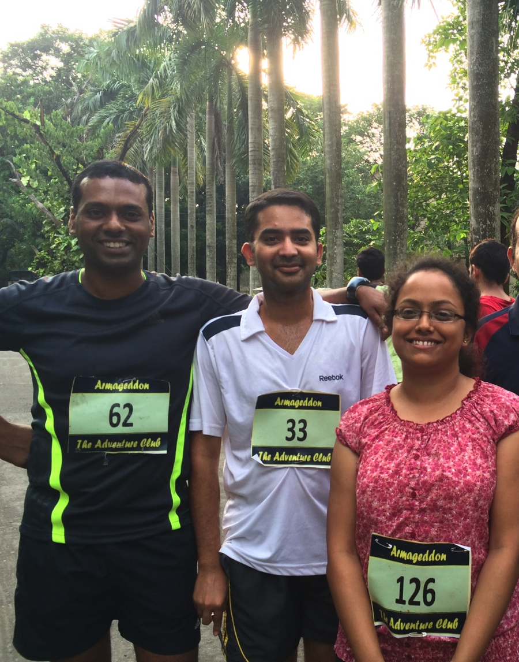
IIM Calcutta and YOU
Just one constraint – how much time you are able to devote
Bangalore World 10K

Slide 19
Our recruiters

Slide 20
Sector wise offers - 2014

Slide 21

Reach us at
Contact
PGPEX Office
IIM Calcutta
Diamond Harbour Road, Joka
Kolkata 700 104
West Bengal, India
Tel: +91 33 2467 8300
Fax: +91 33 2467 6629
Website: http://www.iimcal.ac.in/PGPEX
e-mail: pgpex@iimcal.ac.in, pgpexconnect@iimcal.ac.in
Facebook: https://www.facebook.com/iimcpgpex

Slide 22
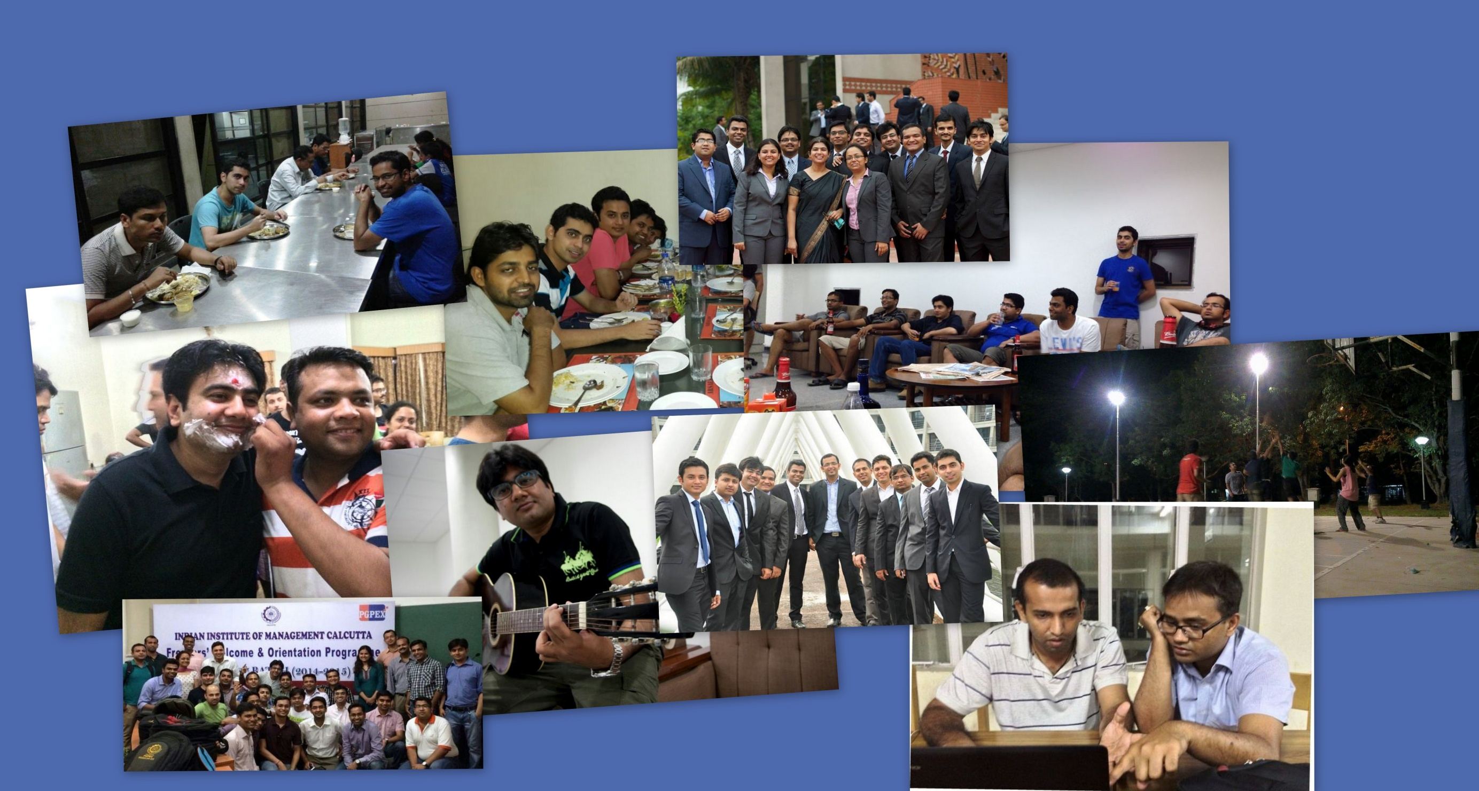
Glimpses of PGPEX life

Slide 23
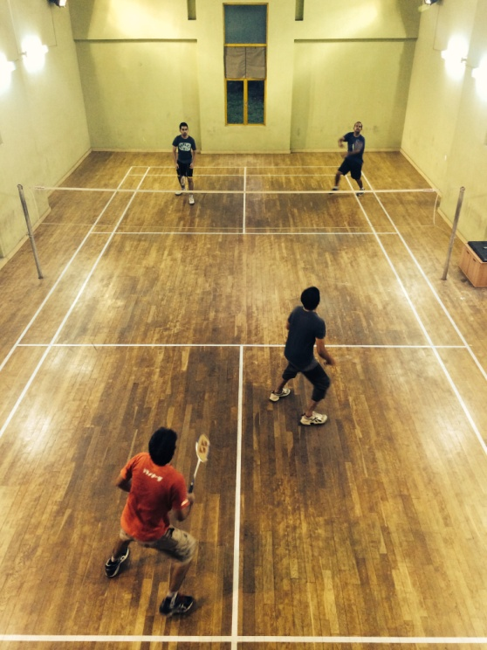
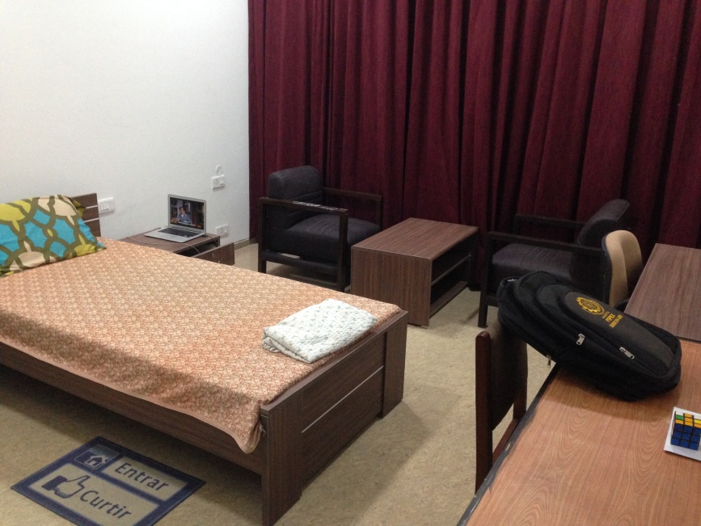
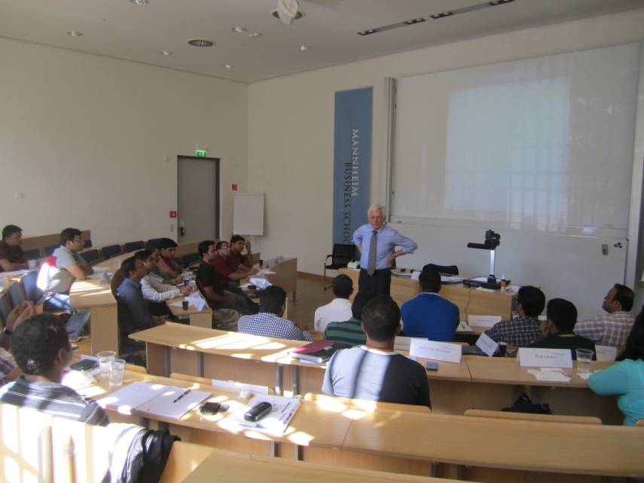
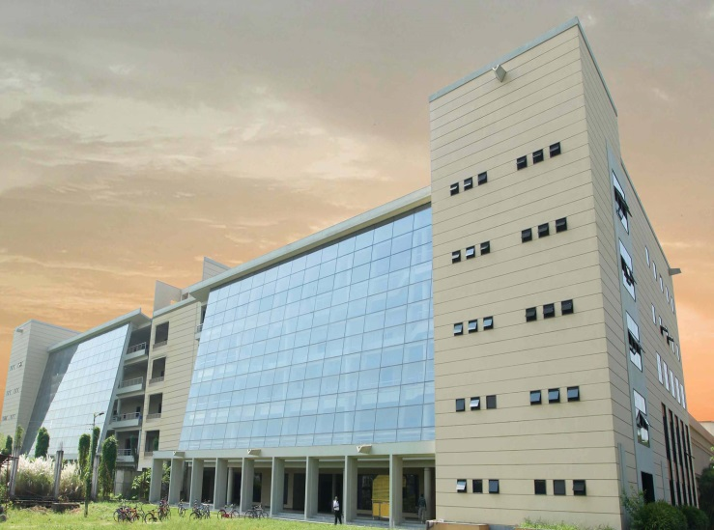
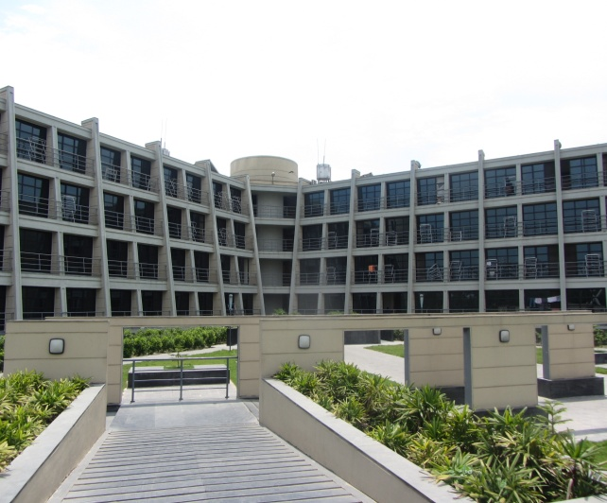
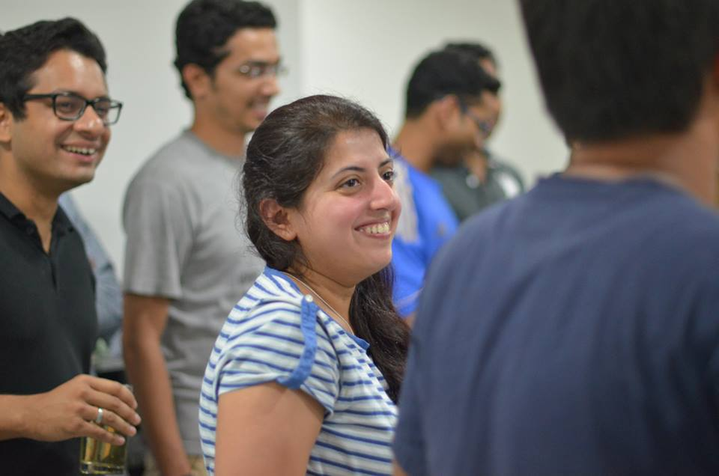
Glimpses of PGPEX life

Slide 24





Entrepreneurial Ventures by PGPEXers
Professional networking
Ashish Anand Chaturvedi
Class of 2012
HealthCare Sector
Arvind Kumar
Class of 2009
Product Review
Surjendu Kuila
Class of 2010
Career Counseling
Sharad Bhatt
Class of 2007
Education Sector
Pankaj Agarwal
Class of 2007

Slide 25
The application process
5 years of professional experience
Bachelor’s Degree or Equivalent
GMAT
Professional experience
GMAT
Selection process
Statement of purpose/Essays
Two Recommendations
Academic record
Personal interview

Slide 26

Important dates
Milestone | Dates
Submission of Completed Application Forms | August 31st 2014
Announcement of short-listed candidates | Second Half of September 2014
Interview of short-listed candidates | Second Half of October 2014
Announcement of selected candidates | Second Half of November 2014
New journey begins…. | April 20th 2015

Slide 27
Questions

