Slide 2
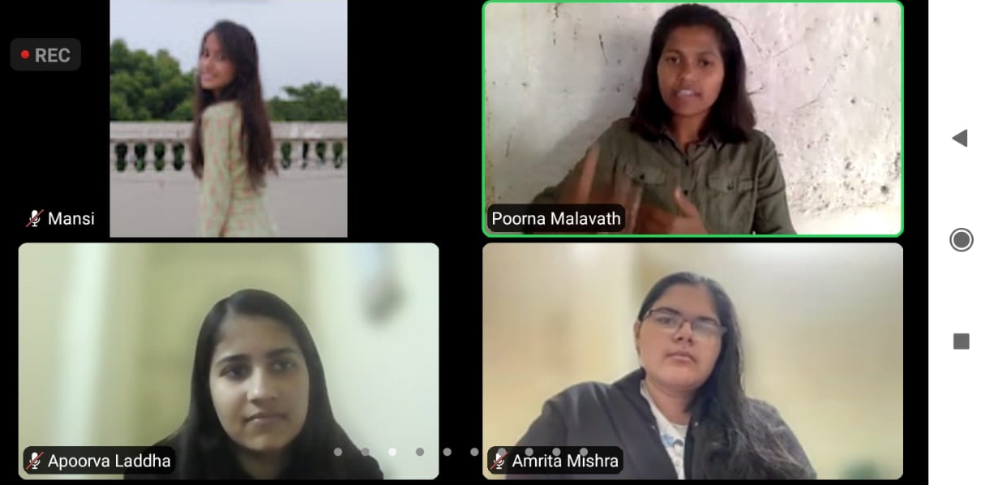
Attendees of the session

Slide 3
Highlights of the session
Internal Complaints Committee, in association with Club Armageddon, arranged for a webinar and interactive session with Ms Malavath Purna on December 26, 2021 (Sunday) at 4:00 p.m. for the Institute’s Community.
Ms Purna is as an Indian mountaineer. On 25 May 2014, she scaled Mount Everest at the age of 13 years and 11 months. She is the youngest Indian and the youngest woman in the world to have reached the summit.
Ms Purna spoke at great length about the various obstacles that she faced in her journey as a woman and how she overcame them by breaking all gender stereotypes.
The experiences and learnings she shared inspired the participants, especially women, to embark on their path to success in an otherwise male-dominated society.
The event was attended by 54 participants and was a success.

